Slide 1

OUR ENVIRONMENT
Introduction, Addition of waste to the environment

Slide 2

Dear students let us begin another interesting lesson from our syllabus ....

Slide 3


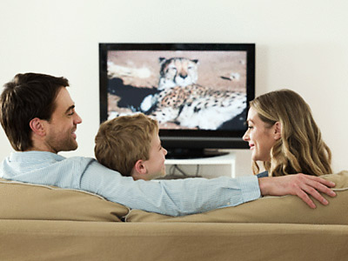

OUR ENVIRONMENT
We have heard the word ‘environment’ often being used on the
television, in newspapers and by people around us.

Slide 4
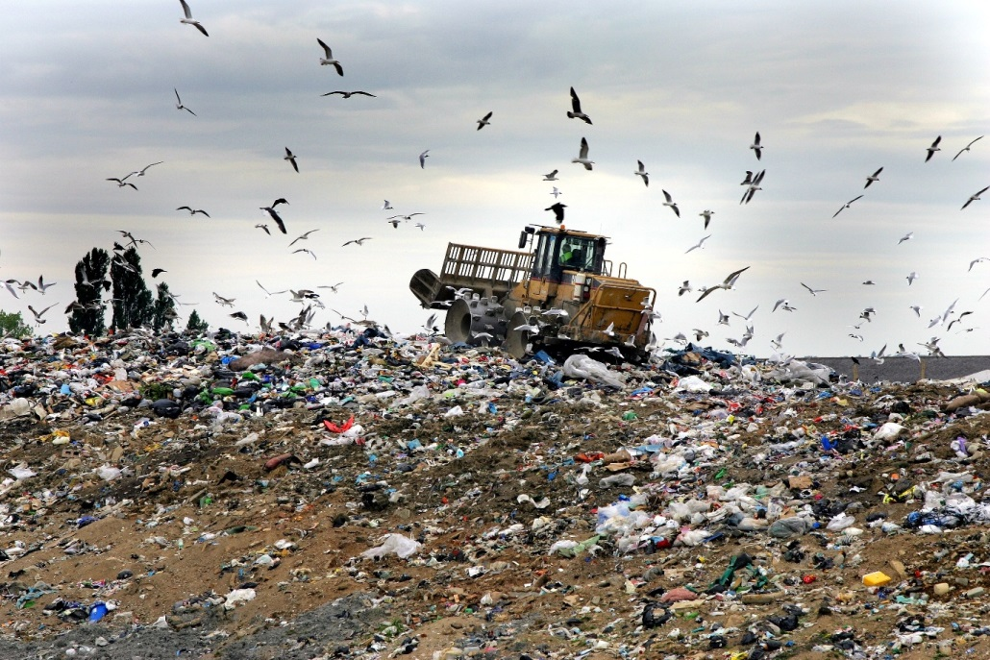
What happens when we add our waste to the environment?
In our daily activities, we generate a lot of material that are thrown away.

Slide 5
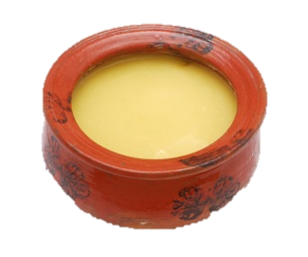
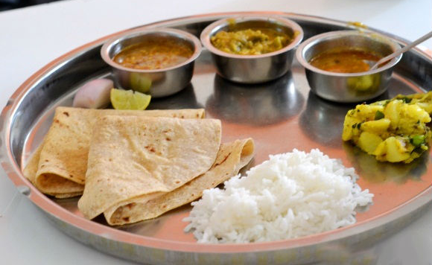
We have seen that the food we eat is digested by various enzymes in our body.
Enzymes are specific in their action, specific enzymes are needed for the break-down of a particular substance.
Proteins
Fats
Carbohydrates

Slide 6
Let us understand this concept with the help of three examples

Slide 7
Amino acids
The enzyme Trypsin :
Fatty acids
Pancreatic amylase Digests carbohydrates into glucose
Proteins
Fats
Trypsin
Lipase
The enzyme Pancreatic amylase
The enzyme Lipase :
Glucose
Lipase digests fats into fatty acid
Trypsin digests proteins into amino acids
Pancreatic amylase
Carbohydrates

Slide 8
Thank You

